Slide 1

FOOD RECIPE RECOMMENDATION SYSTEM
BY :
DHIVYA SWAMINATHAN
SHILPA SINGH
SUMEET MISHRA
LUDDY SCHOOL OF INFORMATICS, COMPUTING AND ENGINEERING

Slide 2
Introduction
Objective:
In this project, we are trying to build the main components of a Recipe Recommendation system which will take ingredients as input and suggest the recipes for these ingredients.
Motivation:
With the prevalence of internet, whole world is connected, and different users of different countries are sharing millions of new recipes on the internet world-wide. So, as a result users are not aware of the all the recipes on the web. In such scenario, a recipe recommendation system which can predict the recipes by taking the list of ingredients as input will be very useful to them.
LUDDY SCHOOL OF INFORMATICS, COMPUTING AND ENGINEERING

Slide 3
Implementation
Data Collection: We collected around 435 recipes from the Allrecipes website, its sub-categories and all its pages using a web-crawler using the BeautifulSoup package in python.
Reference data creation: From all the above recipes we gathered the set of unique ingredients and prepared the reference data for lookup which could be used by the annotation task.
Corpus Annotation: We scanned all the recipe files using a script, divided them into sentences through core-nlp and annotated each token in the sentence as “B-OTH” if it was an ingredient and “O” if it was not an ingredient.
Pre-processing: Then we prepared training data from the annotated files using some pre-processing techniques.
LSTM with Elmo Model: For ingredient identification in recipes, we tried LSTM and LSTM with Elmo Embeddings which gave good accuracy.
Recipe Prediction: Then we created a text classification model to predict recipes from the ingredients.
LUDDY SCHOOL OF INFORMATICS, COMPUTING AND ENGINEERING

Slide 4
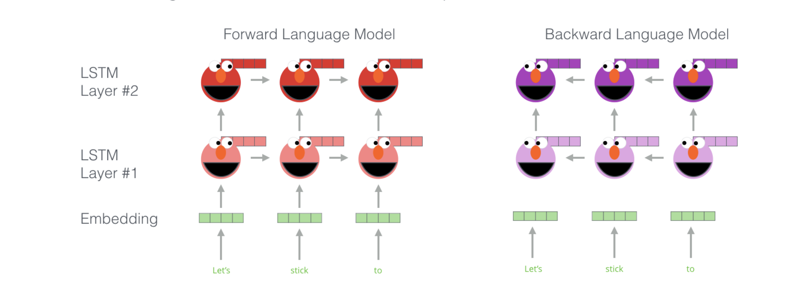
Architecture
ELMO Language Model: ELMo gained its language understanding from being trained to predict the next word in a sequence of words - a task called Language Modeling
LUDDY SCHOOL OF INFORMATICS, COMPUTING AND ENGINEERING

Slide 5
Model
LUDDY SCHOOL OF INFORMATICS, COMPUTING AND ENGINEERING

Slide 6
Experiment Results
Precision | Recall | F1-score
95 | 93 | 94
input_1: ['serve' 'hot' 'with' 'tortillas' 'and' 'shredded' 'cheese' 'allowing'
'everyone' 'to' 'make' 'their' 'own' 'fajita' '.' 'PADword' 'PADword']
output_1 :['O', 'O', 'O', 'B-OTH', 'O', 'O', 'B-OTH', 'O', 'O', 'O', 'O', 'O', 'O', 'O', 'O', 'O']
input_2: ['in' 'a' 'large' 'bowl' 'cream' 'sugar' 'and' 'butter' 'or' 'margarine'
'.' 'PADword' 'PADword' 'PADword' 'PADword' 'PADword' 'PADword' 'PADword']
output_2 :['O', 'O', 'O', 'O', 'B-OTH','B-OTH', 'O', 'B-OTH', 'O', 'B-OTH', 'O', 'O', 'O', 'O', 'O']
LUDDY SCHOOL OF INFORMATICS, COMPUTING AND ENGINEERING

Slide 7
Text Classification Model
It takes ingredients as input and recipe name as ground truth for training.
It learns to predict recipes from given set of ingredients.
Work | Recipe Files Trained | Train Accuracy | Test Accuracy
Predict recipes from ingredients | 32 | 87% | 42%
LUDDY SCHOOL OF INFORMATICS, COMPUTING AND ENGINEERING

Slide 8
Results
Input
['bean', 'chillies', 'choice', 'mint','tahiini', 'garbanzos', 'sesame']
Prediction
Predicted label: monastery_style_bean_soup
Predicted label: hoomos
Ground Truth
hoomos: [tahiini, garbanzos, sesame]
monastery_style_bean_soup: [bean, chillies, choice, mint]
LUDDY SCHOOL OF INFORMATICS, COMPUTING AND ENGINEERING

Slide 9
Results
Input
['apples','bananas','eggs', 'tomato','lettuce', 'ham', 'creme', 'eggs', 'creamy', 'nicely']
Prediction
Predicted label: healthy_asian_apple_soup
Predicted label: quick_and_dirty
Predicted label: lettuce_soup
Predicted label: easy_microwave_tomato
Ground Truth
healthy_asian_apple_soup: [apple, apples, pears, pearl, ham]
lettuce_soup: [lettuce, ham, creme, eggs, creamy, nicely]
quick_and_dirty: [coil]
easy_microwave_tomato: [tomato]
LUDDY SCHOOL OF INFORMATICS, COMPUTING AND ENGINEERING

Slide 10
Future Scope
The next step would be to train our model with all the recipes we scraped and annotated and observe model performance.
The long-term goal of this project is to implement this onto a home-assistance device like Amazon Alexa or Google Home by using their speech processing module to take input from the user and suggest recipes accordingly.
Technical enhancement as a next step include:
Taking into consideration quantities of ingredients available with the user and suggest recipes based on quantity as well.
Suggesting Top 5 or Top 10 close match recipes.
If no recipe found with exact match of ingredients, build a module to suggest what more ingredients are required to accomplish the suggested recipe avoiding the allergic ingredients/recipes to the user if any.
LUDDY SCHOOL OF INFORMATICS, COMPUTING AND ENGINEERING

